Slide 1
Nowcasting Malaysia’s GDP using Machine Learning
Prepared by (mentees):
Veronica S. Jamilat
Fatin Ezzati Mohd Aris
Siti Khadijah Jasni (KJ)
Department of Statistics Malaysia
For
Final Check-in: International DS Accelerator
June 29, 2022
Mentor: Will Malpass (Data Science Campus, UK)

Slide 2
Project objectives:
To identify new and potential approach that is nowcasting using machine learning models.
To complement or replace the existing method in producing advanced estimates for GDP.

Slide 3
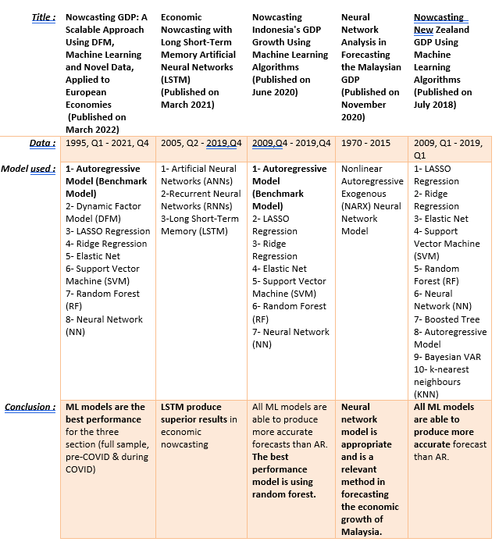
LITERATURE REVIEW

Slide 4
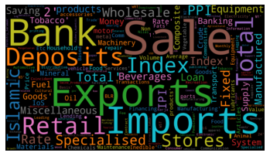
Nowcasting Variables
Total: 112 variables
Frequency: Monthly & Quarterly
Time-series: Unbalanced dataset
Source: Surveys & Administrative data

Slide 5
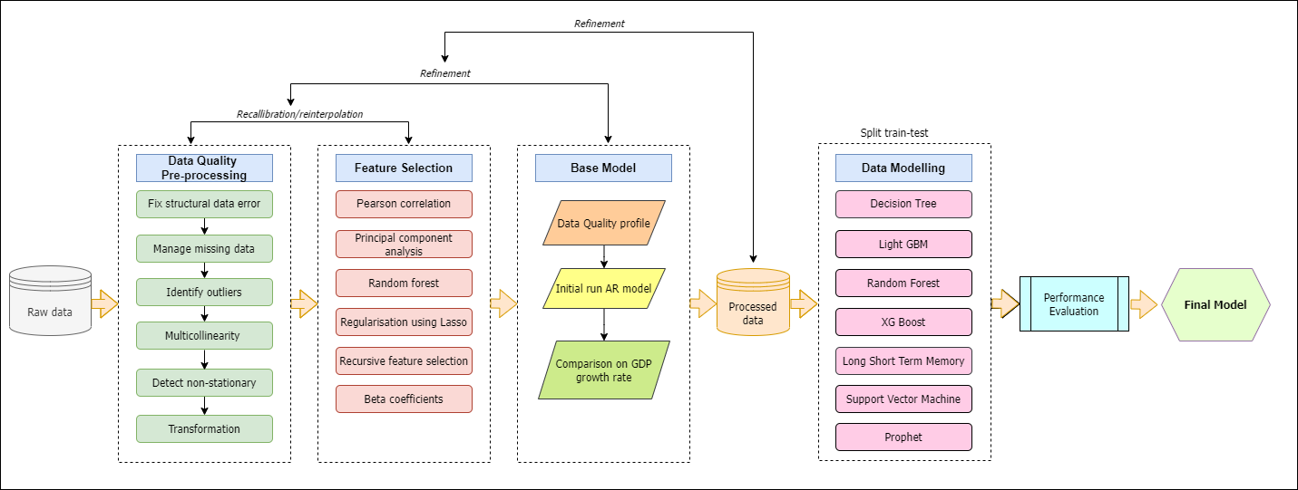
Methodology Framework

Slide 6
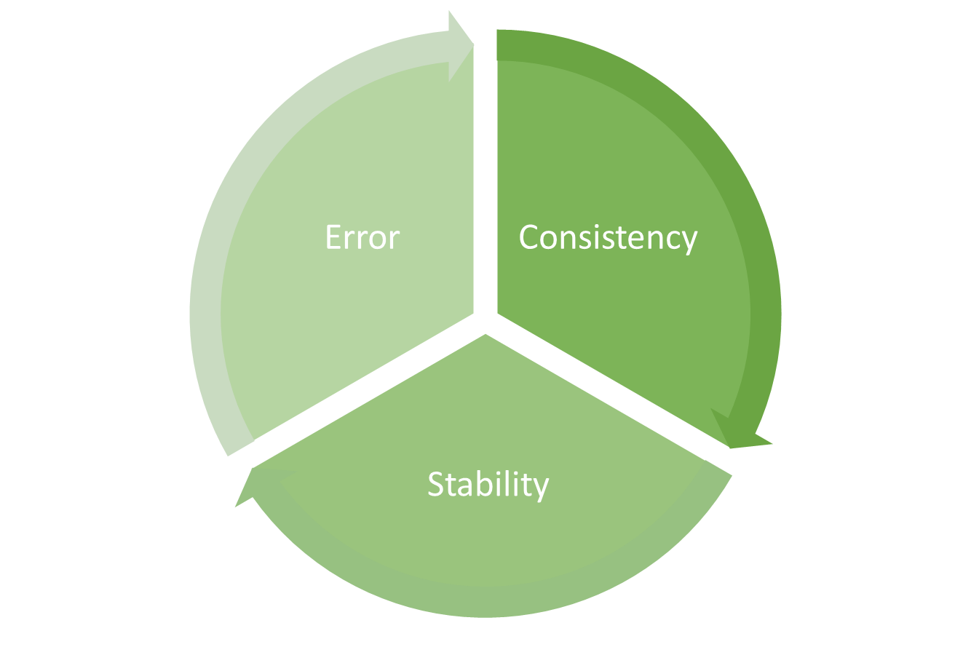
Criterion Model Selection:
The model selection are based on:
The lowest value of error
The consistency and stability in terms of model
Criterion Model Selection

Slide 7
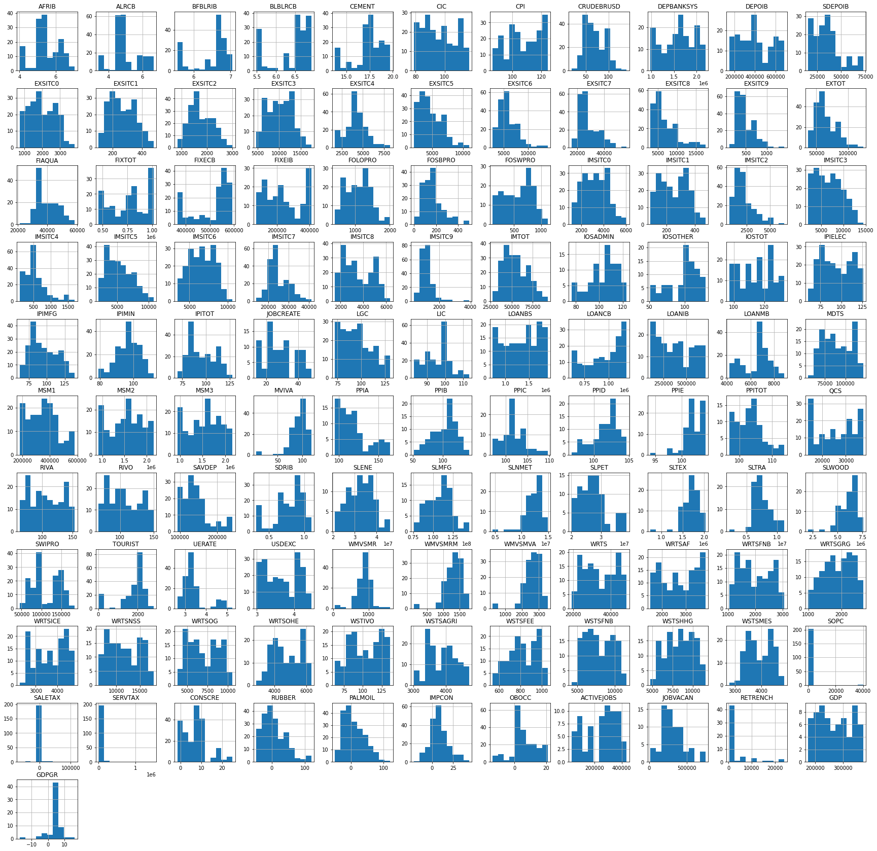
Data Exploration
As expected, distribution, patterns and characteristics for every variables varies:
Approx. normal
Skewed (some are highly skewed)
Bimodal
Next step missing values check

Slide 8
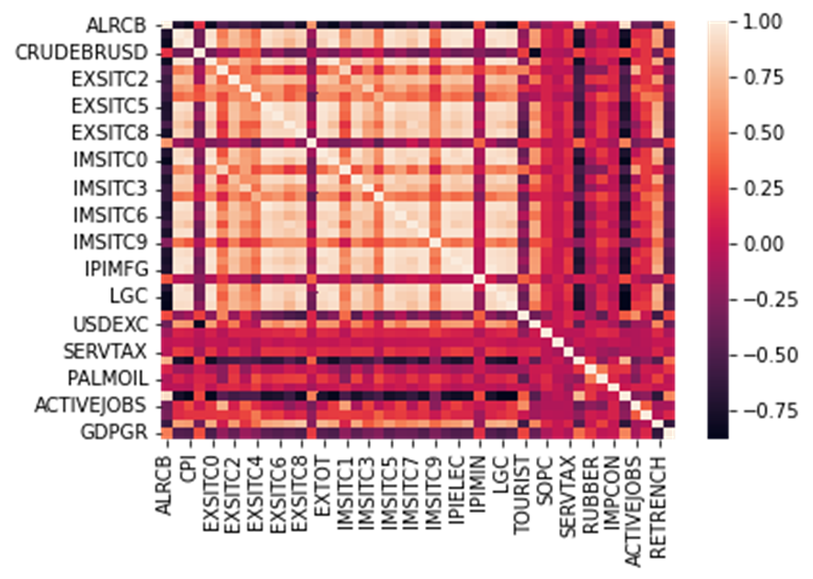
Data Pre-processing: Missing values and correlation
To achieve balanced data:
Select variables with reasonable back-series data
Drop variables with missing values (more than 10%)
47 (out of 112) variables selected to the next step correlation check

Slide 9
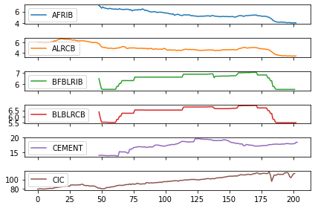
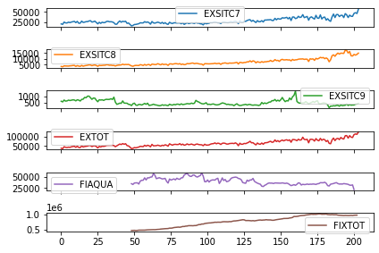
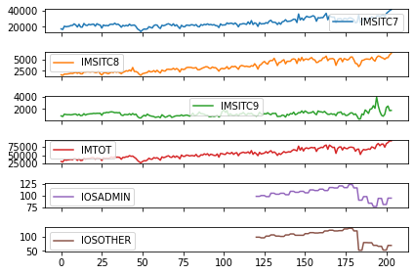
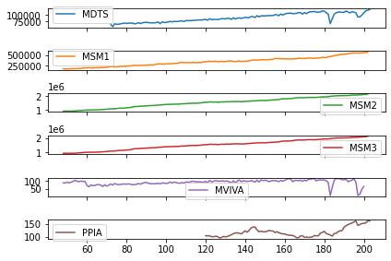
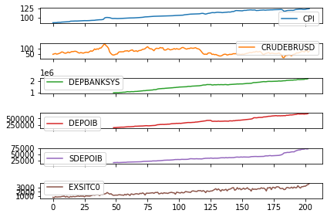
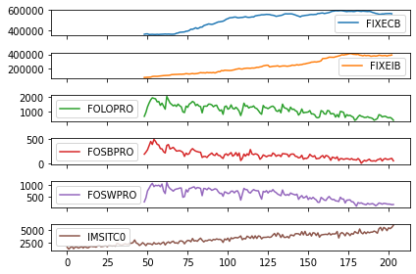
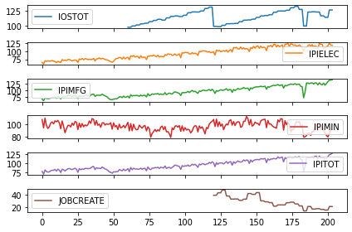
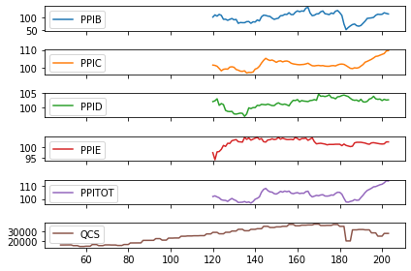
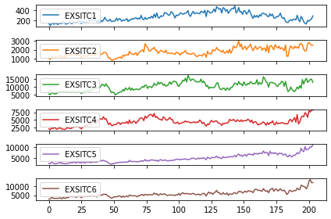
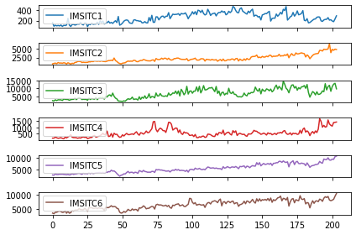
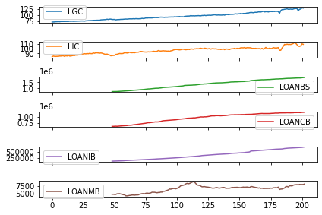
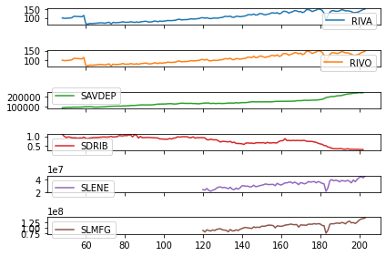
Data pre-processing: Stationarity
Every variables are non-stationary:

Slide 10
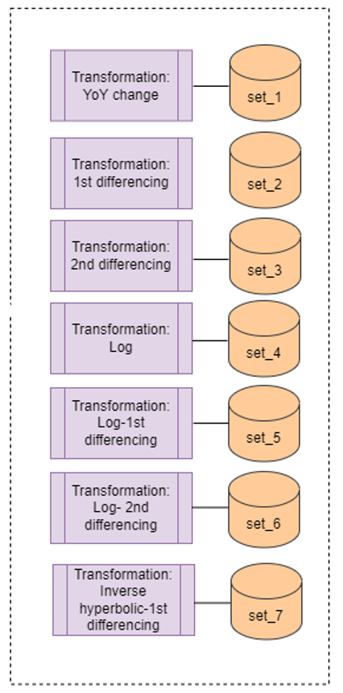
Transformation Methods
To ensure all the variables are stationary
First differencing
Second differencing
Log-first and second differencing
Year-on-year change
Inverse hyperbolic sine function (arcsinh) - 1st differencing
* Note: Labour data contain negative values

Slide 11
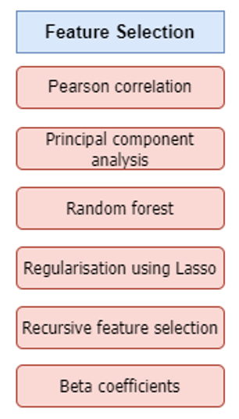
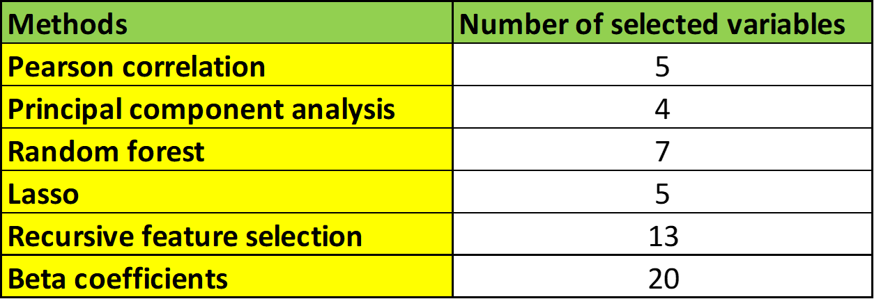
Variable Selection
Advanced estimates using all these variables (variables selection method) to produce GDP
Using all variables (after dropping all vars with missing values) produce better results
Therefore, more variables needed to capture factors / signals to nowcast gdp
Variable Selection

Slide 12
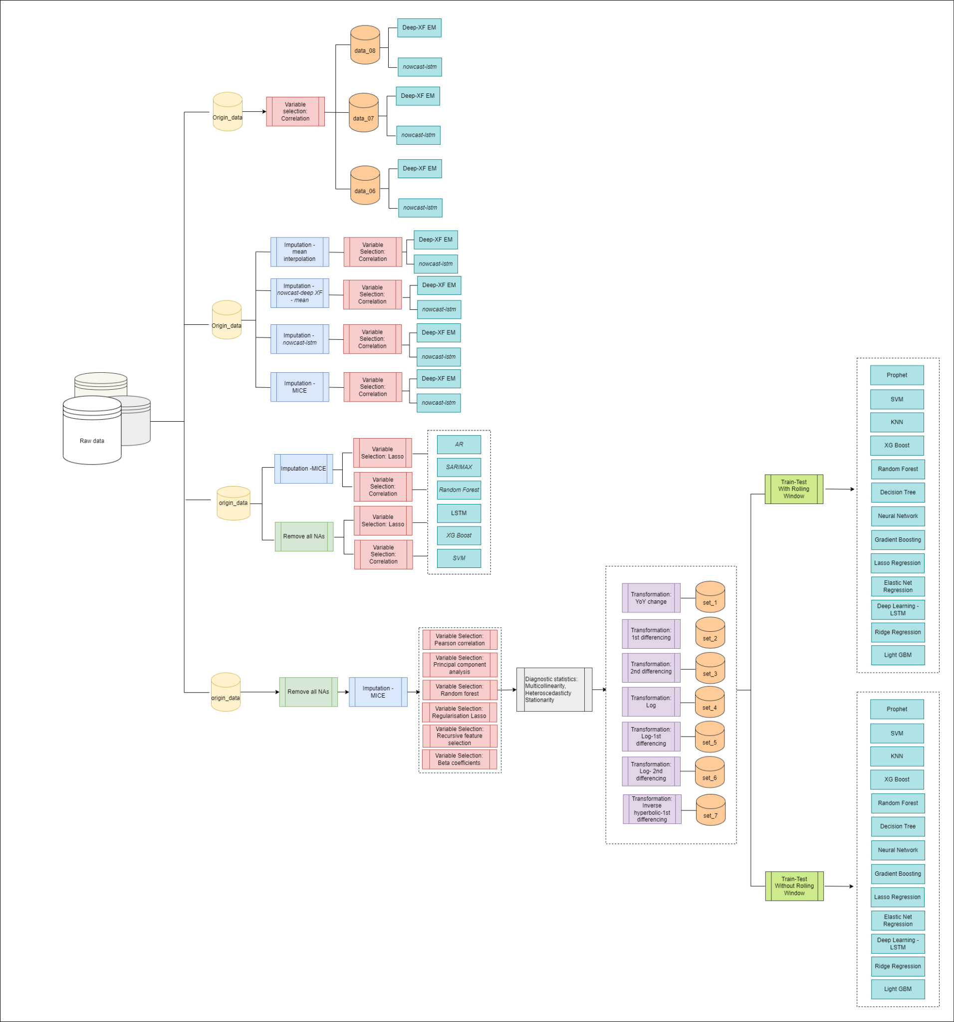
Overall Experiments
Benchmark Model: AR
All four experiments varies from:
Imputations on missing values
Variables selections
Dataset (split into 3, full data, pre-Covid & during Covid)
ML models
Other models
Software used: Python, R & SAS

Slide 13
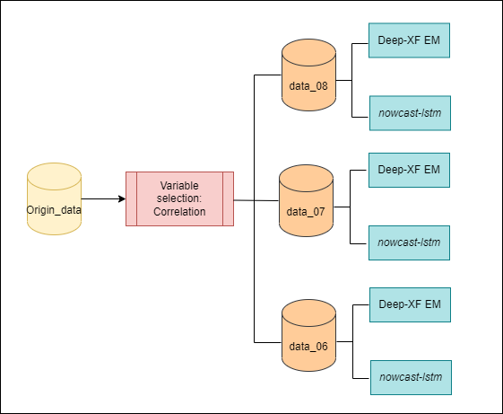
1st Experiments
For 1st experiment:
Imputations on missing values
Variables selection: correlation
Dataset (split into 3 data sets)
ML models: Expected Maximization & LSTM)

Slide 14
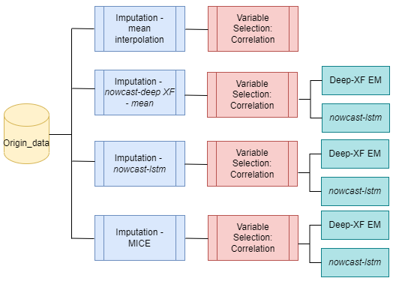
2nd Experiment
For 2nd experiment:
Imputations on missing values: 4 methods
Variables selections: correlation
Dataset: full data
ML models: Expected Maximization
& LSTM

Slide 15
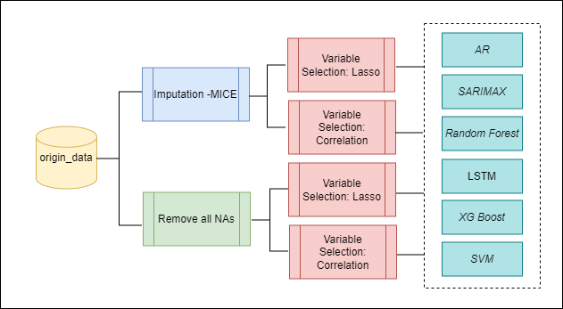
3rd Experiment
For 3rd experiment:
Imputations on missing values: MICE & remove NAs
Variables selections: LASSO & correlation
Dataset: full data
ML models: Random Forest, LSTM, XG Boost & SVM

Slide 16
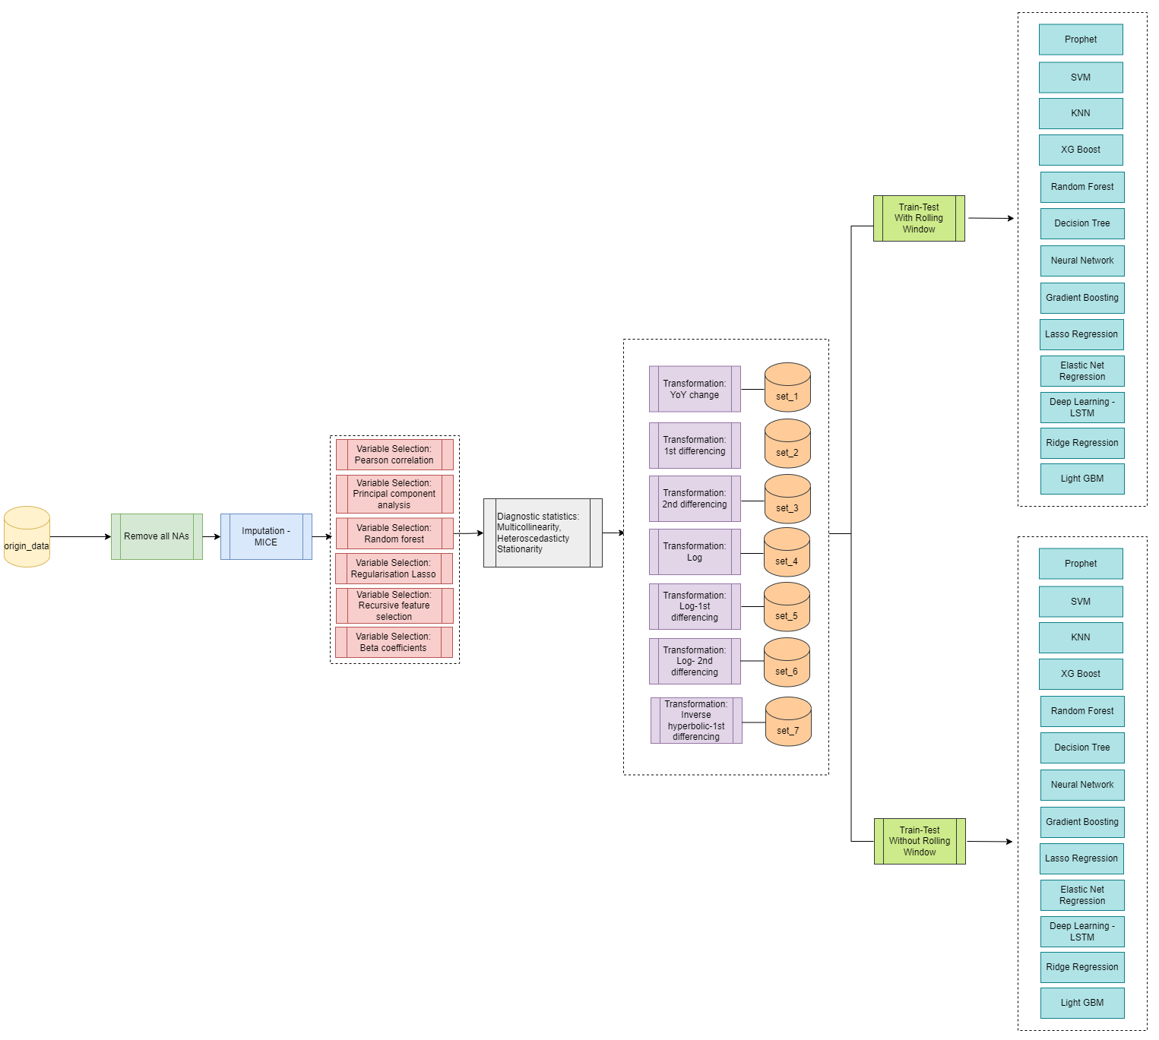
4th experiment
For 4th experiment:
Drop variables with NAs more than 10%
Imputations on missing values: MICE
Applied various techniques of transformation
Variables selections: 6 methods
Train-test-validate set with/ without rolling window

Slide 17
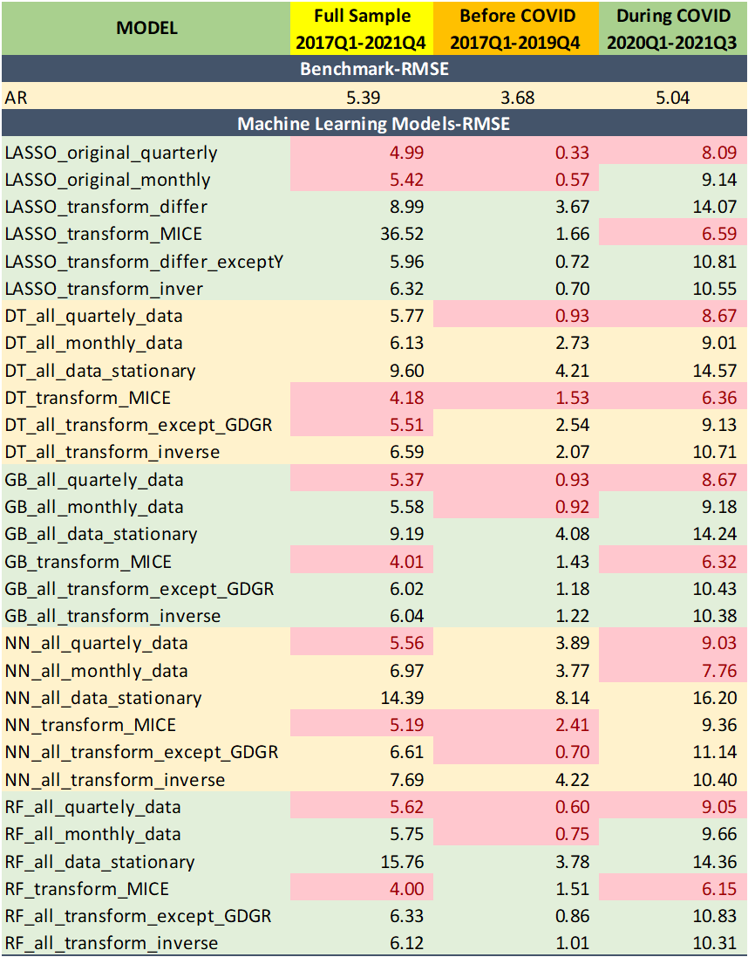
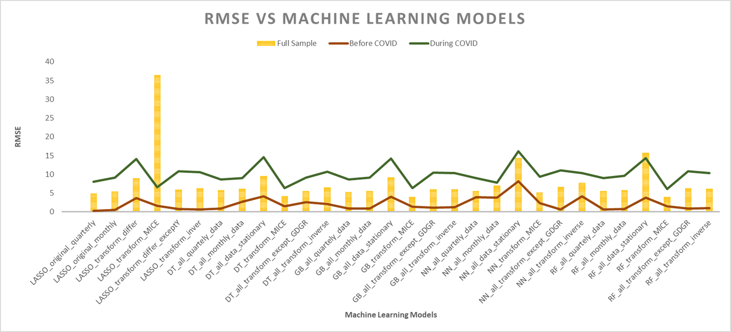
RESULT
As expected, the RMSEs during normal times (before COVID) are lower than that during the COVID period.

Slide 18
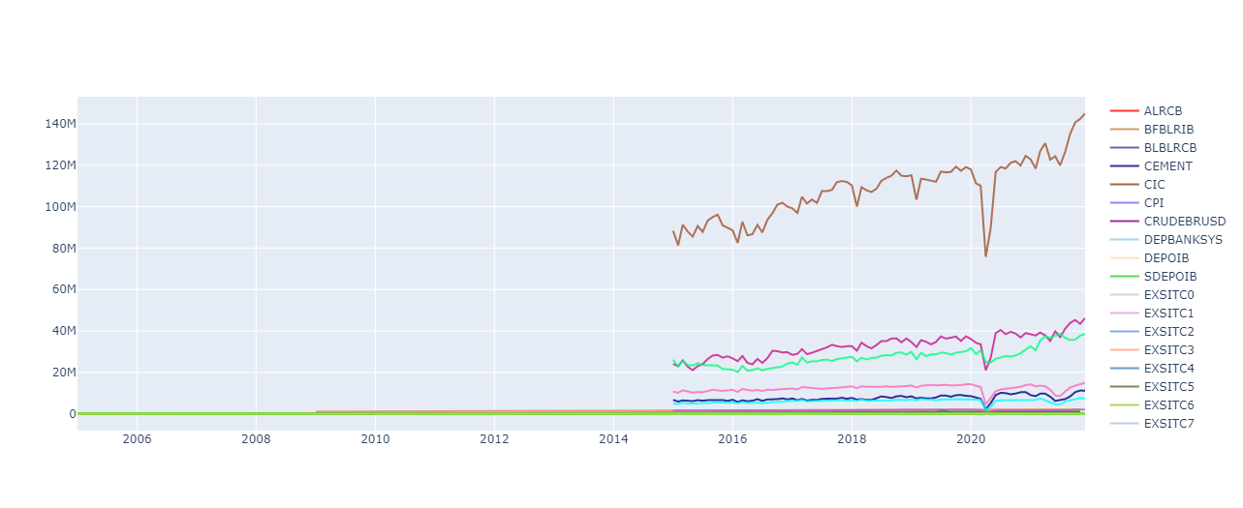
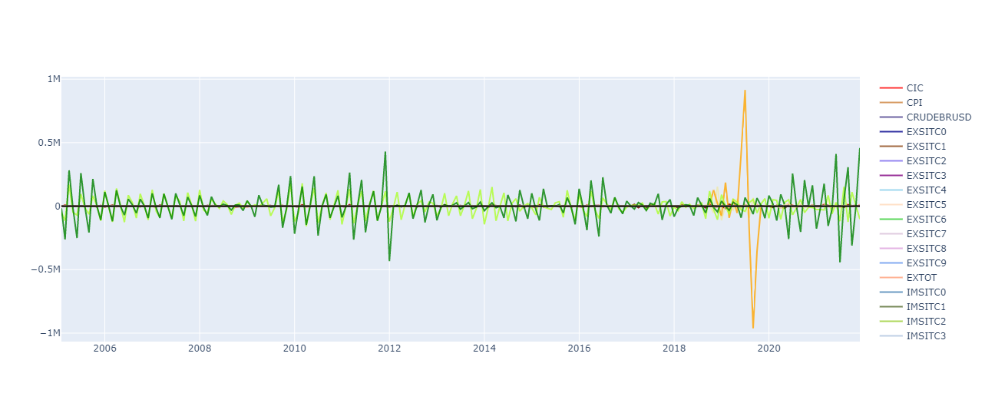
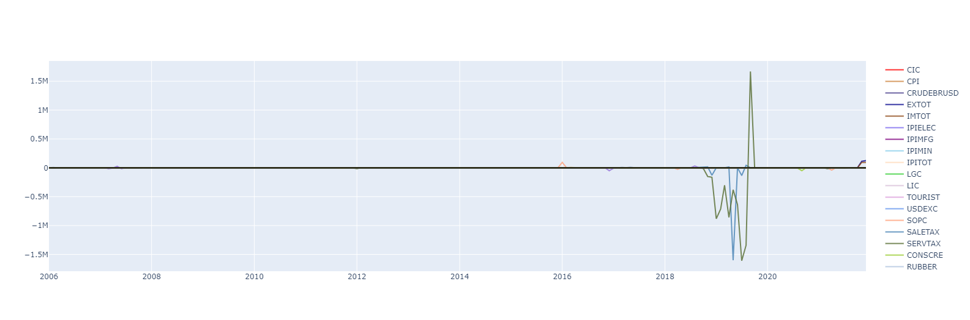
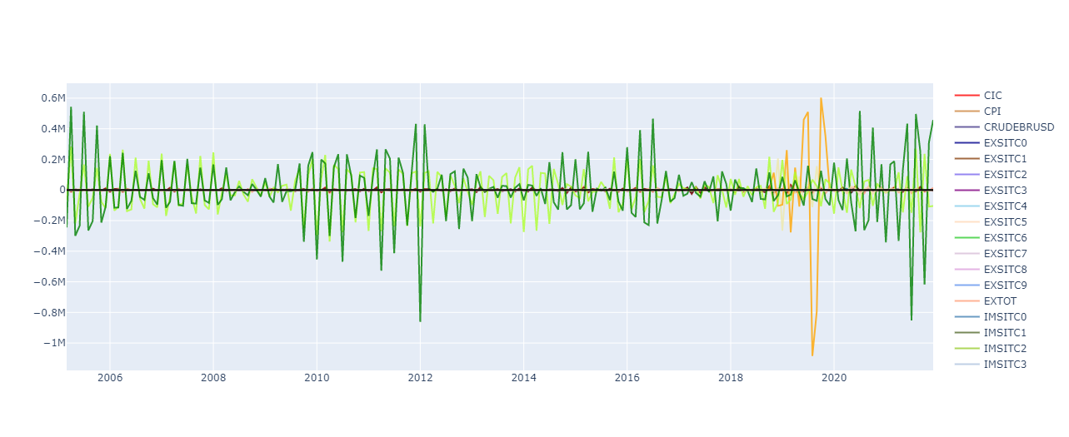
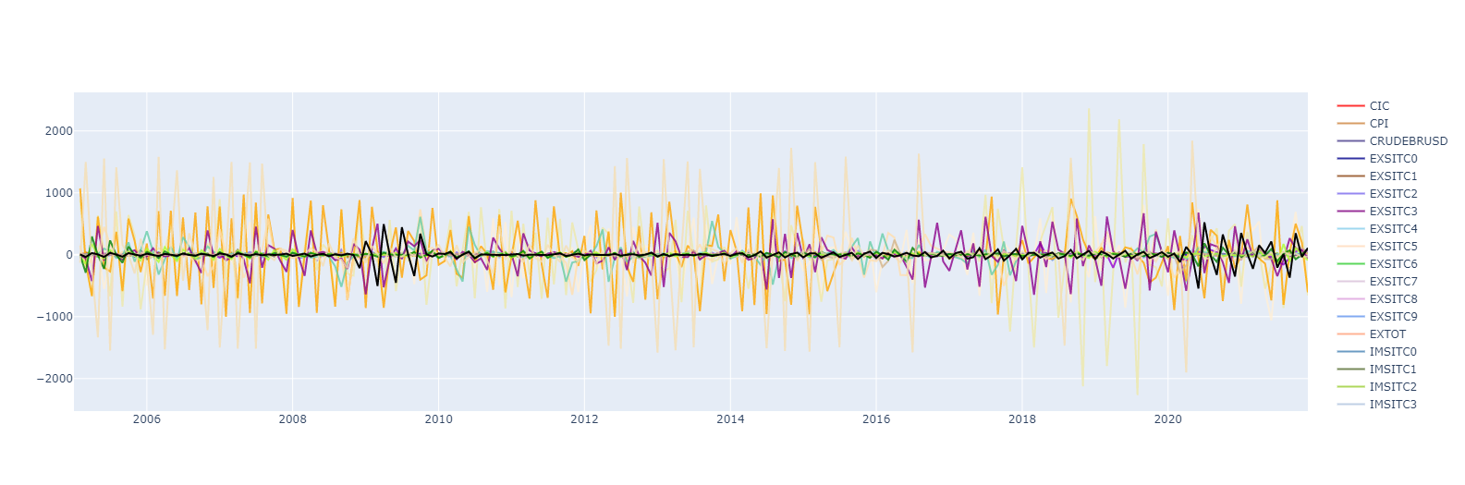
Comparison Transformation Method
No transformation
1st differencing
YoY %
2nd differencing
Arcsinh

Slide 19
No transformation
1st differencing
YoY %
2nd differencing
Arcsinh

Slide 20
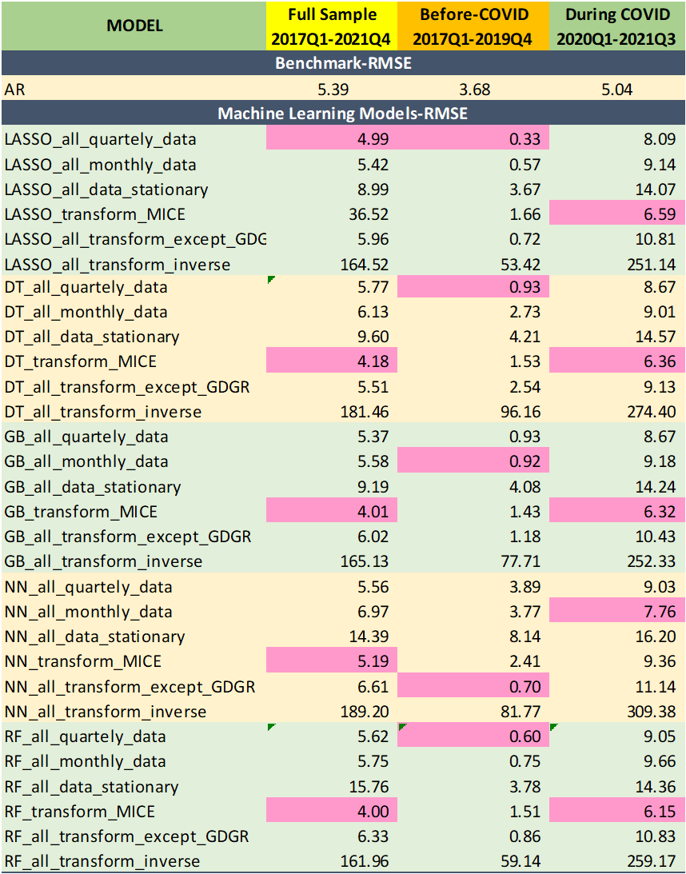
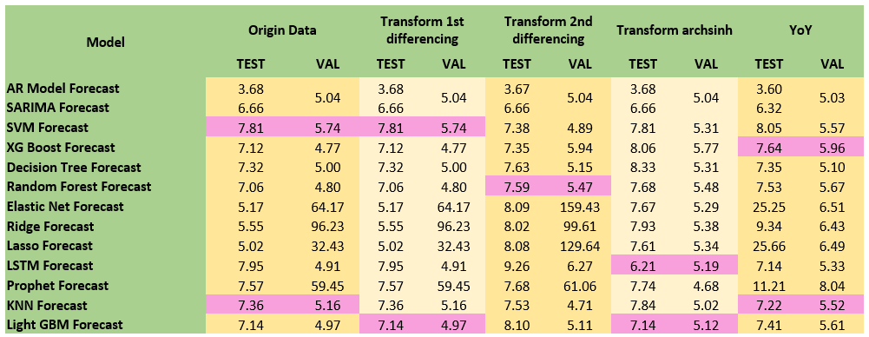
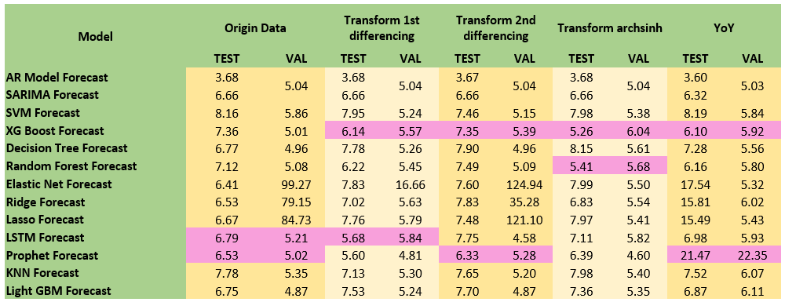
PYTHON
SAS
Without rolling
With rolling

Slide 21
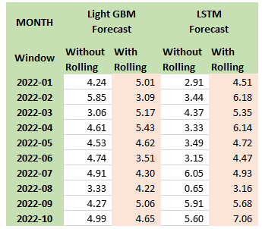
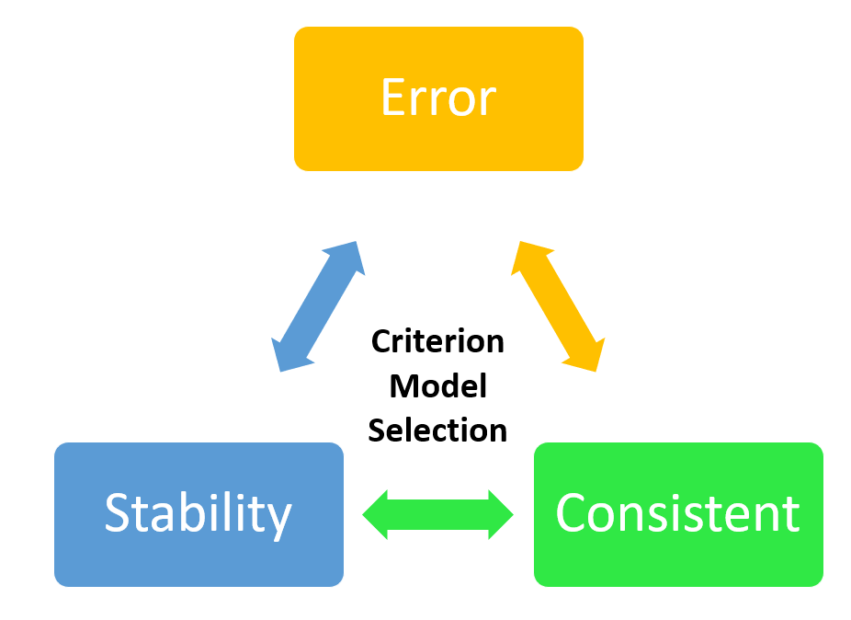
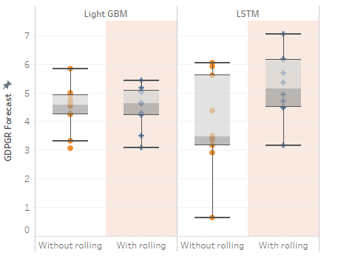
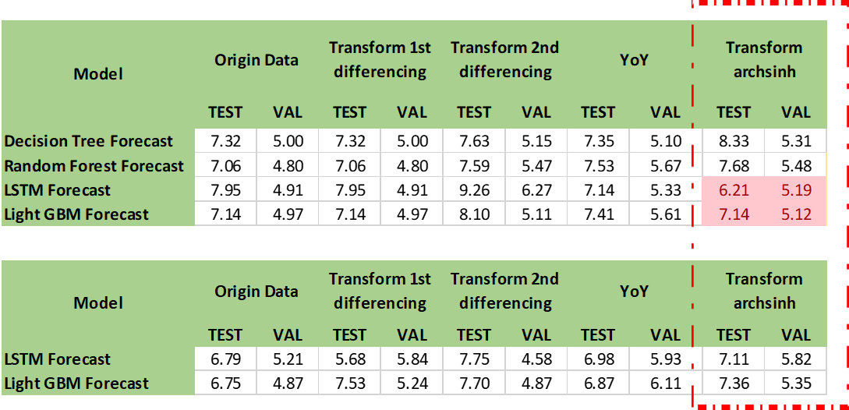
Decision: Criterion Model Selection
Without rolling
With rolling

Slide 22
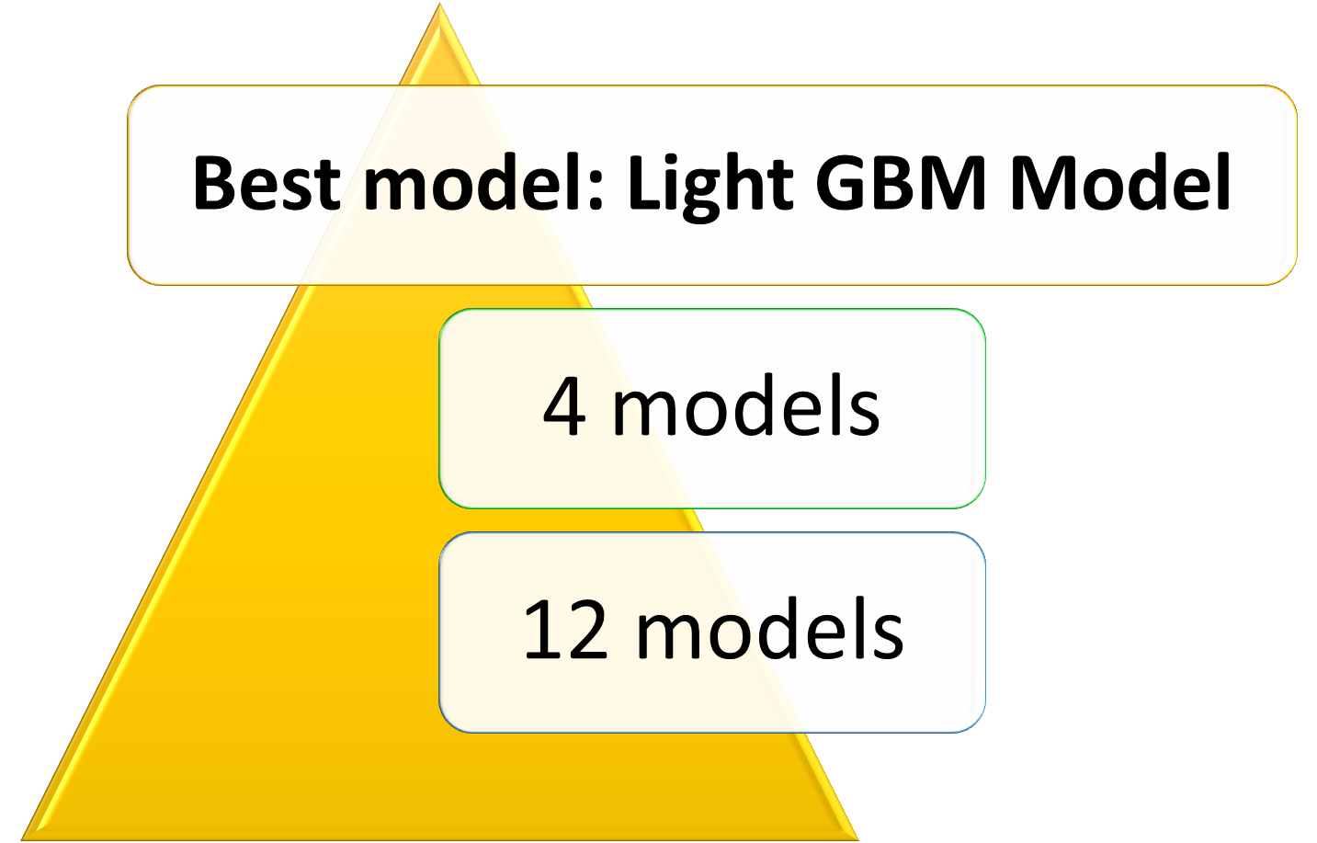

Final Result: Best Model
The Best Model to nowcast Malaysia’s GDP is Light GBM Model

Slide 23
Conclusions:
Future works:
Machine learning models outperform benchmark model.
Light GBM found to be the best model to nowcast Malaysia’s GDP.
Use MIDAS as a benchmark as it is established in the nowcasting literature compared to the AR model.
Adding newspaper articles that contain timely economic signals to materially improve nowcasts of real GDP growth.

Slide 24
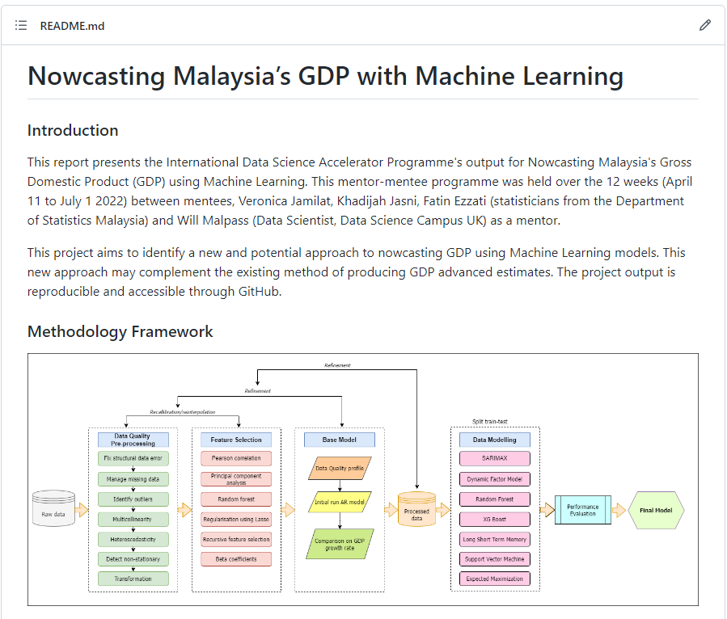
Github
https://github.com/DSctadr/Nowcasting-Malaysia-GDP

Slide 25
No Transformation
Variables that are non-stationary:

Slide 26
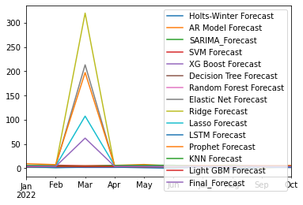
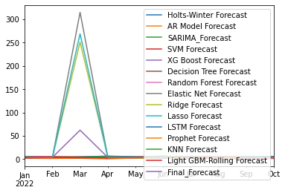
Result: No transformation
Without rolling
With rolling

Slide 27
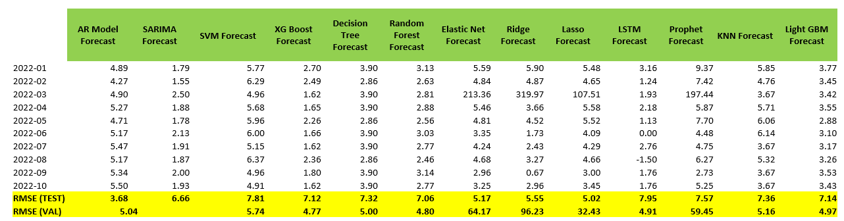
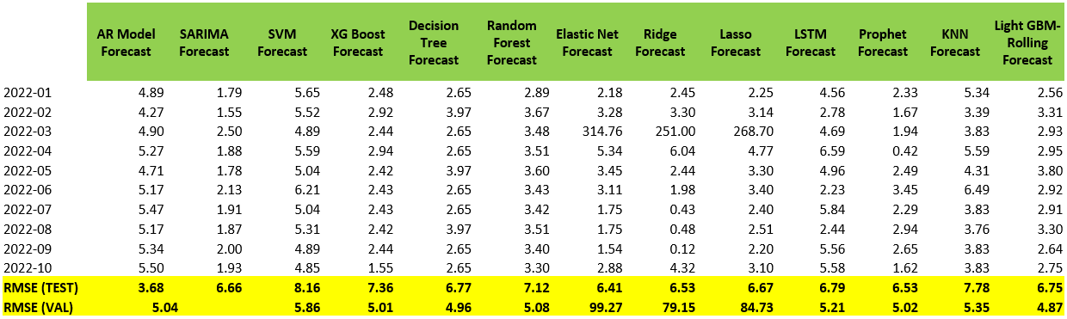
Result: Forecast (No Transformation)
Without rolling
With rolling
Notes:
Test: 2020-04 until 2021-1
Validation: 2021-02 until 2021-12

Slide 28
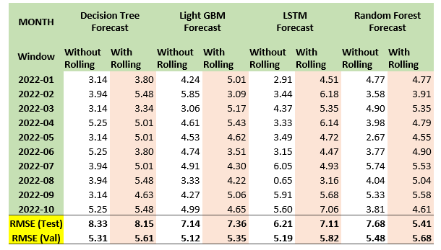
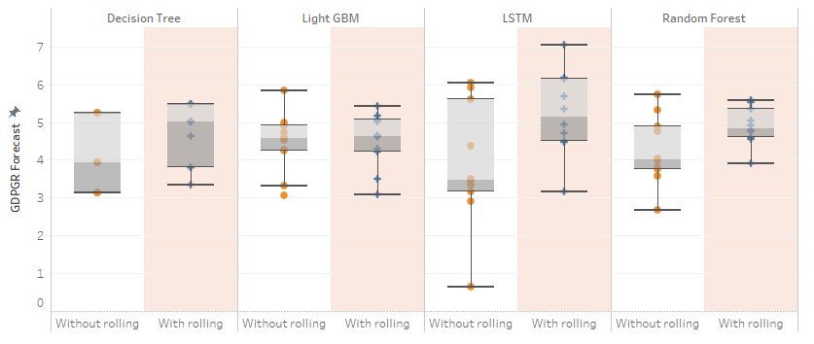
Decision: Criterion Model Selection
Without rolling
With rolling

Slide 29
Transformation: YoY %
Most of the variables are stationary
Variables that are non-stationary:

Slide 30
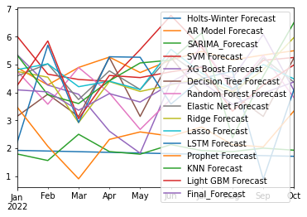
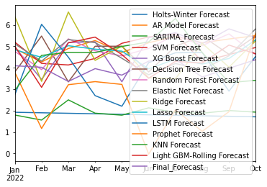
Result: Transformation Inverse Hyperbolic - Arcsinh
Without rolling
With rolling

Slide 31


Results: Transformation: YoY %
Without rolling
With rolling

Slide 32


Result: Forecast (YoY%)
Without
rolling
With rolling
Notes:
Test: 2020-04
until 2021-1
Validation: 2021-02
until 2021-12

Slide 33
Transformation - 1st Differencing
Most of the variables are stationary
Variables that are non-stationary:

Slide 34


Result: Transformation 1st Differencing
Without rolling
With rolling

Slide 35


Result: Forecast (Transformation 1st Differencing)
Without
rolling
Without rolling
Notes:
Test: 2020-04 until
2021-1
Validation: 2021-02 until 2021-12

Slide 36
Transformation - 2nd Differencing
Most of the variables are stationary
Variables that are non-stationary:

Slide 37


Result: Transformation 2nd Differencing
Without rolling
With rolling

Slide 38


Result: Forecast (Transformation 2nd Differencing)
Without rolling
With rolling
Notes:
Test: 2020-04 until
2021-1
Validation: 2021-02 until
2021-12

Slide 39
Transformation: Archsinh
And finally….all variables are stationary

Slide 40


Result: Forecast (Transformation Inverse Hyperbolic - Arcsinh)
Without
rolling
With rolling
Notes:
Test: 2020-04 until
2021-1
Validation: 2021-02 until
2021-12

Slide 41












RMSE: 111.06 MAE: 27.98
RMSE: 8.77
MAE: 6.95
RMSE: 7.53
MAE: 3.68
RMSE: 131.35
MAE: 31.66
RMSE: 141.12
MAE: 33.59
RMSE: 9.003
MAE: 7.53
RMSE: 122.11
MAE: 30.03
RMSE: 8.16
MAE: 6.64
RMSE: 8.69
MAE: 7.08
RMSE: 10.101
MAE: 7.98
RMSE: 8.621
MAE: 6.43

Slide 42


Slide 43












AR
LIGHT GBM
LASSO
RMSE: 5.86
MAE: 3.68
RMSE: 5.91
MAE: 3.91
RMSE: 6.26
MAE: 4.57
RIDGE
KNN
PROPHET
RMSE:6.43
MAE: 4.41
RMSE: 6.25
MAE: 4.59
RMSE: 6.17
MAE: 3.48
MODEL PERFORMANCE
ELASTIC NET
RANDOM FOREST
DECISION TREE
RMSE: 6.24
MAE: 4.57
RMSE: 6.33
MAE: 4.23
RMSE: 6.23
MAE: 4.37
XG BOOST
SVM
LSTM
RMSE: 6.53
MAE: 4.46
RMSE: 6.37
MAE: 4.83
RMSE: 5.86
MAE: 3.94

